Slide 1
The Resource Group
Notes:
Add slide around categories

Slide 2
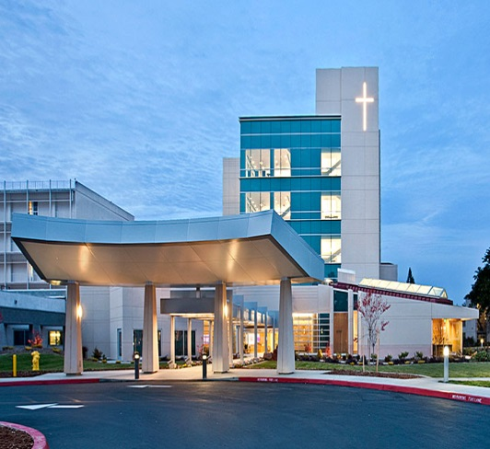
The Resource Group By The Numbers
$7.4B
Managed Non-Payroll Spend
Through our promise to listen, innovate, and implement, we deliver solutions that accelerate healthcare organization’s financial performance
4M+ Supply Chain Labor Hours Overseen Annually
927K+ POs Processed Annually
147
Hospitals and 2000 Sites of Care Served Across 70M Square Feet
1500+
Supply Chain Associates Managed
1.38M+Annual Courier Supply Stops
632K+ Requisitions Processed Annually
744K+
SKUs¹ managed in perpetual and par locations
¹ SKU – Stock Keeping Unit

Slide 3
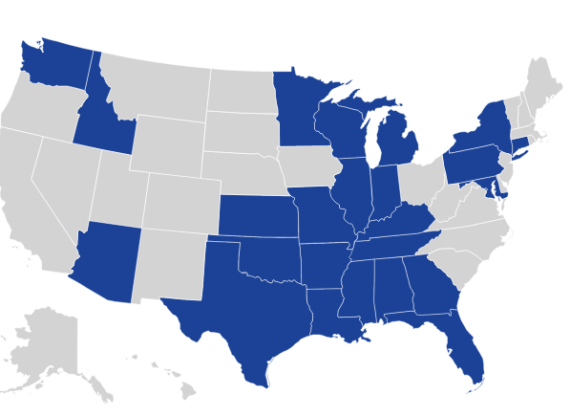
The Resource Group’s Breadth
Notes:
Over 140 acute care facilities
1,900 sites of care

Slide 4
Results Driven
$868M
Annual Expense Reduction
$648M in Supplies and $220M in Other Non-Payroll Spend

Slide 5
Value Realization Equation™
Execution + Discipline + Process + Controls + Talent Investment = Value Realization
Limited Business Transformation
Transactional Supply Chain Roles
Cost Stabilization
Business Transformation
Comprehensive Roles
Area Chief Resource Officer
Area Operations Director
Area Implementation Director
Area Critical Products Director
Cost Optimization: 8% to 10% Savings
Process + Controls
Execution + Discipline
Fragmented Process and Controls
Transactional Supply Chain Roles
Cost Escalation
Fragmented Process and Controls
Comprehensive Roles
Area Chief Resource Officer
Area Operations Director
Area Implementation Director
Area Critical Products Director
Cost Escalation
Talent Investment

Slide 6
Contract Portfolio – Categories of Interest
The Resource Group provides value across each of the large healthcare spend categories
Medical Surgical Supplies
Pharmacy Supplies
Information Technology Software and Hardware
Medical/Non-Medical Equipment – Major and Minor
Construction
Purchased Services

Slide 7
Our Experience at Non-Acute Facilities
Typical Savings Percent
8%
*Conservative estimate provided as The Resource Group has seen savings in the
double digits and provides the most value in the physician preference category,
which is typically a low spend category at non-acute facilities

Slide 8
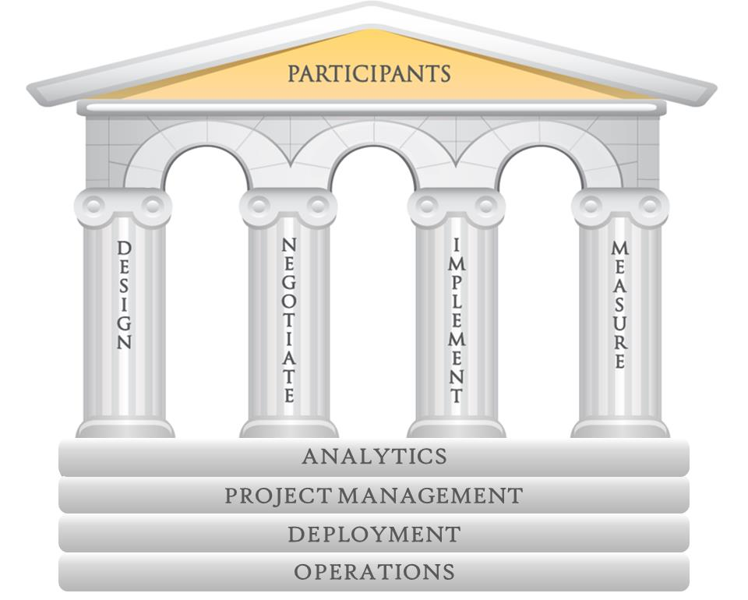
Four Pillars of User-Directed Strategic Sourcing™
The User-Directed Strategic Sourcing™ model reduces price and variation while improving quality through integrated change management. This model differs from the traditional procurement models which attempt to lower cost through category management and limiting choice.
Communication
Collaboration
Communication

Slide 9
User-Directed Strategic Sourcing™: Affinity Group and Decision Teams
Guiding Principles developed by Clinical Excellence and The Resource Group will guide clinical decisions
The Resource Group will facilitate the process
Clinical Governing Body will support the process
Clinicians from all systems will participate
All acceptable Suppliers will be identified for negotiation purposes
The selection process will be transparent
Existing clinical quality initiatives will be incorporated
The process will take advantage of existing scientific evidence if available

Slide 10
User-Directed Strategic Sourcing™: Simplification of Decision-Making
Five key attributes are considered when determining acceptable products or services
End-User Satisfaction
Clinical/Safety Considerations
Financial Opportunity
Patient Satisfaction
Mission/Values/Values Alignment

Slide 11
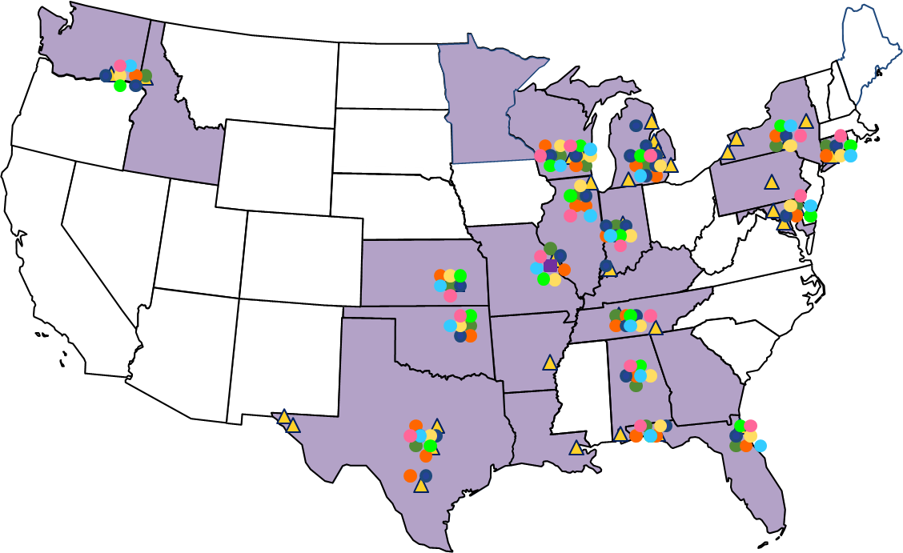
Integrated to Accelerate Change and Results
The Resource Group integrates locally while connecting nationally through seven Communities of Expertise and four Communities of Collaboration
System Office
Participants
Chief Resource Officer
Operations Leader
Analyst
Implementation Specialist
Critical Products Manager
Customer Care Person
Data Steward
Area Leadership
Communities of Collaboration:
Clinical Sponsors
Executive Sponsors
Decision Teams
Affinity Groups

Slide 12
Talent Investment
The Resource Group continues to build a diverse team with cross industry expertise
Healthcare Providers
Healthcare Manufacturing and Distribution
Group Purchasing, Supply Chain and Logistics
Consulting and Finance
Manufacturing and Retail
Adventist Health
Alexian Brothers Health System
Ascension Health
Aurora Health Care
BJC Healthcare
Chan Healthcare
Cleveland Clinic
Genesys Health
Iasis Healthcare
Infirmary Health
Mayo Clinic
Lourdes
Mercy
Seton Healthcare
SSM Healthcare
St. John Providence
St. Joseph Hospital
St. Luke’s Hospital
St. Vincent’s Medical
Tenant Healthcare
Texas Health Resources
Trinity Health
UHC
University of Michigan Health
Ronald Reagan Medical Center
Via Christi Health
Yale-New Haven Health
American Red Cross
AmerisourceBergen
Anthem Blue Cross Blue Shield
Bausch & Lomb
Boston Scientific
Cardinal Health
Cerner
Centene
Covidien
DePuy Synthes
DeRoyal
Emed Medical Company
Express Scripts
Forest Pharmaceuticals
GlaxoSmithKline
Globus Medical
Johnson & Johnson
McKesson
Owens & Minor
Par Pharmaceutical
Pfizer
Quorum Health Resources
Smith & Nephew
Sonosite
TEI Biosciences
The Harvard Drug Group
Sanofi Aventis
Amerinet
APL Logistics
Cummins
Crothall Services Group
Dell
FedEx
HPG
Landstar
MD Logistics
MedAssets
Novation/VHA
OHL Logistics
Premier
ROi
Ryder
Schneider
Tennessee Valley Authority
UPS
Union Pacific Railroad
United States Air Force
United States Army
Accenture
American General Finance
applEcon
CapGemini
Capital One
Cass Information Systems, Inc.
Cassidy Turley
Chase
Crothall Services Group
Cope Health Solutions
Cox
Deloitte
Edward Jones
Enterprise Bank and Trust
Ernst & Young
Federal Reserve Bank
Financial Resource Group
First National Bank
Humana
Integra
KPMG
MetLife Premier Client Group
NCR
PwC
Veterans United Home Loans
Wells Fargo
AB InBev
American Airlines
Boeing
Brown Shoe
Chevron Phillips Chemical
Chrysler
CKE Restaurants
Coca-Cola
ConAgra Foods
Conoco Phillips
Dollar General
Du Pont
Ford
Genesco
Georgia-Pacific
Goodwill
Honeywell
Integra
Ingersoll Rand
JC Penney
Johnson Level
Macy’s
Nissan
Ralcorp
Readers Digest
SC Johnson & Son
Schnucks
Silgan Plastics
Thompson CAT
Walmart
Wiese

Slide 13
Talent Investment
The Resource Group has developed a program that will rapidly prepare associates for leadership roles through leadership development, structured training programs, professional certifications, mentoring, and experiential learning in the following areas
Program Areas
Lean
Six Sigma
APICS
Project Management
Leadership/Mentoring
Nationally recognized certifications
Structured projects and presentations
Assigned mentors
Two – four year career development plan
Sales Development/Marketing
Negotiations

Slide 14
Thank You
John E. Eaker Vice President, Chief Resource Officer — St. Vincent’s Health O: 205.930.2192 | John.Eaker@Ascension.org

